Slide 1
Board of Dental Examiners of Alabama
Website: www.dentalboard.org

Slide 2
Importance of the Website
As a licensee, the website is your one stop source of information regarding new requirements, changes and updates to anything that affects your license, including renewals and reinstatements.
It is strongly advised that you review the website frequently and read the Board minutes each month if you are unable to attend the Board Meeting.

Slide 3
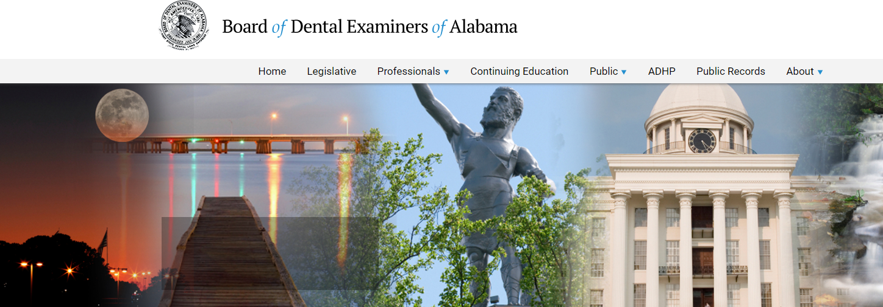
Home page
Link for the Dental Practice Act
Link for the Board Rules
Link for License Lookup – shows the status of any license
Link for License Renewals – The button to click to renew licenses and permits
Contains announcements, board meeting information, and pertinent impending changes

Slide 4
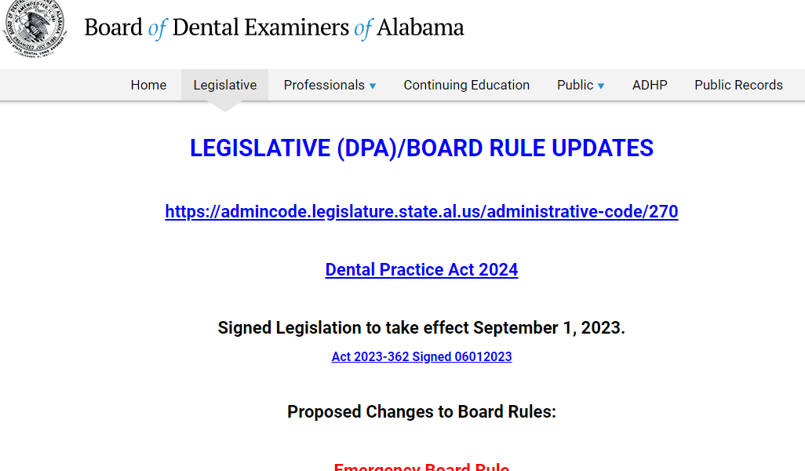
Legislative
Contains all Board Rule updates
Signed Legislation and effective dates

Slide 5
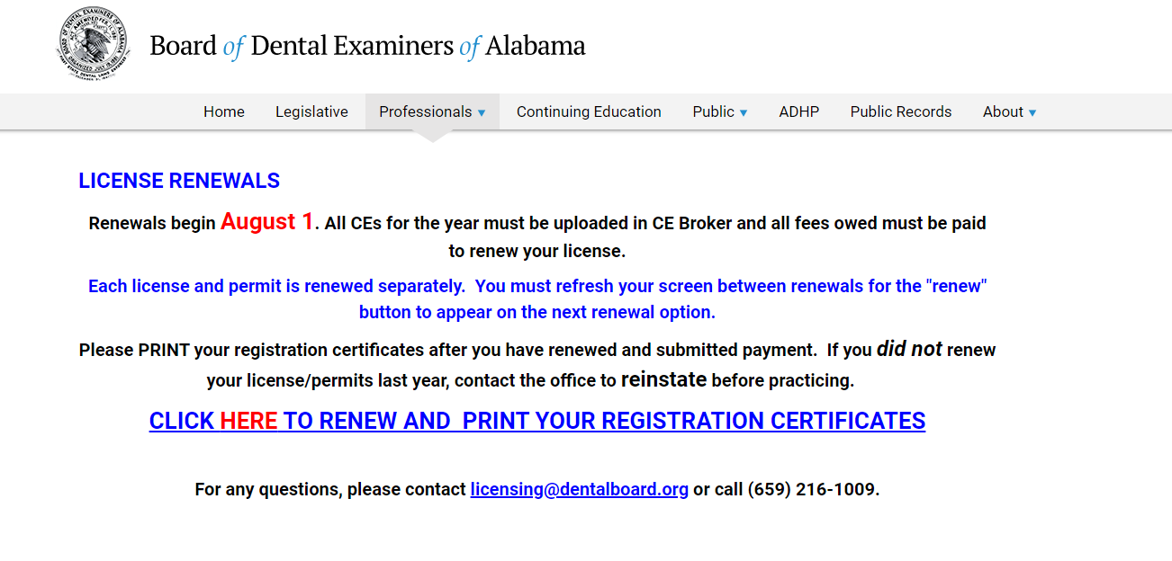
Professionals/License Renewals
Information on beginning of Renewal period
Information regarding what is required to renew
How to print licenses and permits

Slide 6
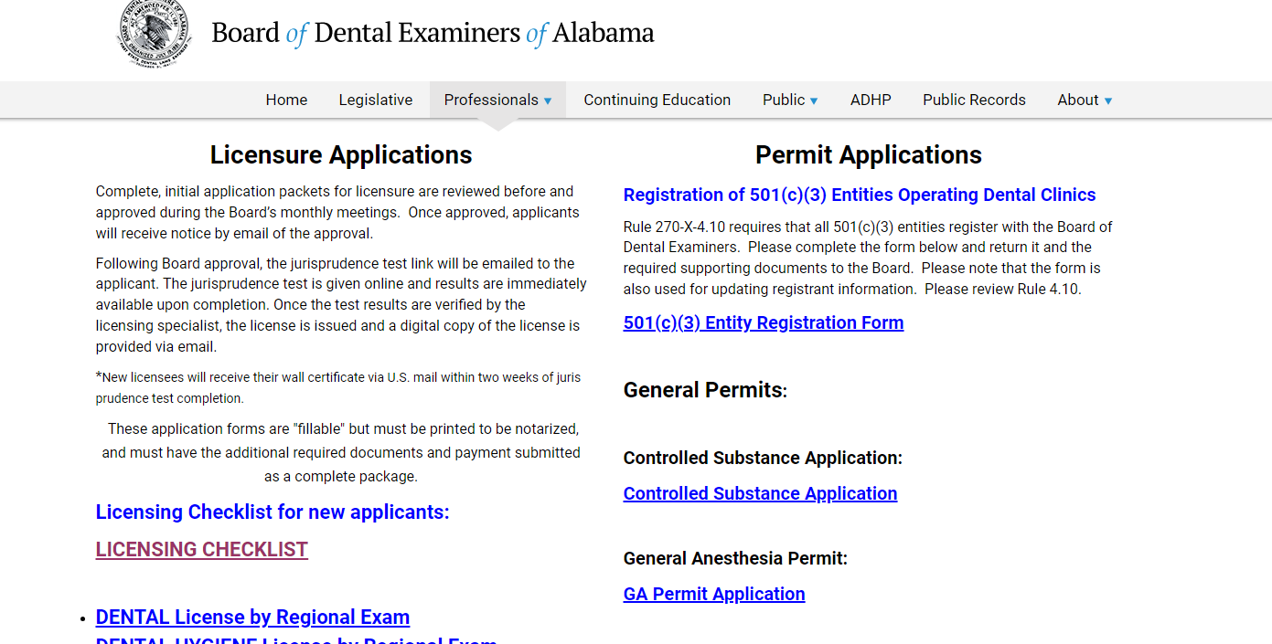
Professionals/State Licensure Applications
Contains all new license applications
Contains all permit applications

Slide 7
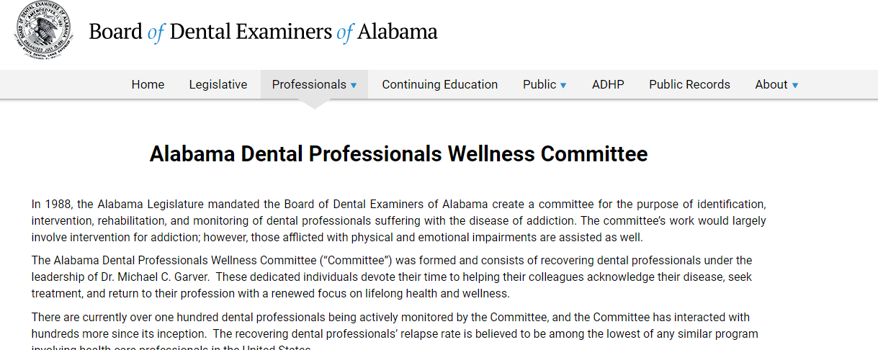
Professionals/Alabama Dental Professionals Wellness Committee
History regarding the program and its mission
Contact information for assistance
Forms for attendance and verification

Slide 8
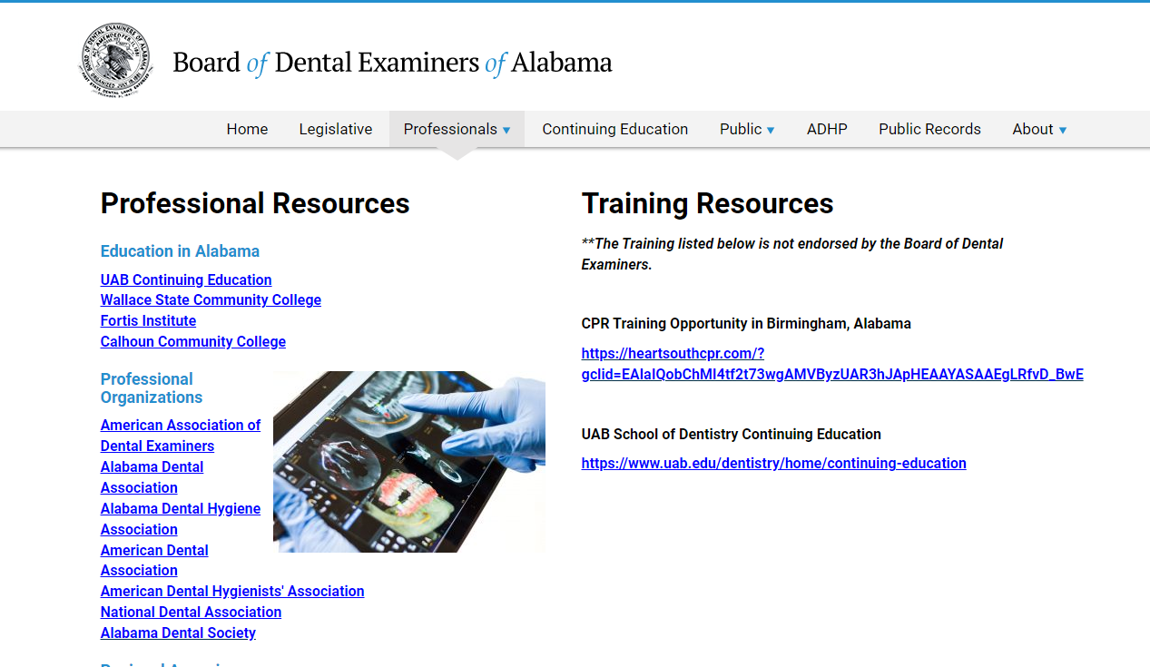
Professionals/Training and Professional Resources
Lists Professional Resources and Organizations with direct links
Lists Training Resources sent to the Board for announcement

Slide 9
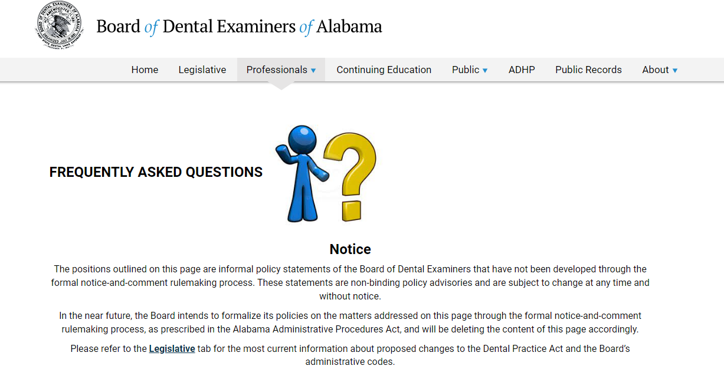
Professionals/FAQs
This page contains Frequently Asked Questions about differing subjects regarding dentistry and Board opinions.
The page is also used to clarify topics of importance or concern to licensees.

Slide 10
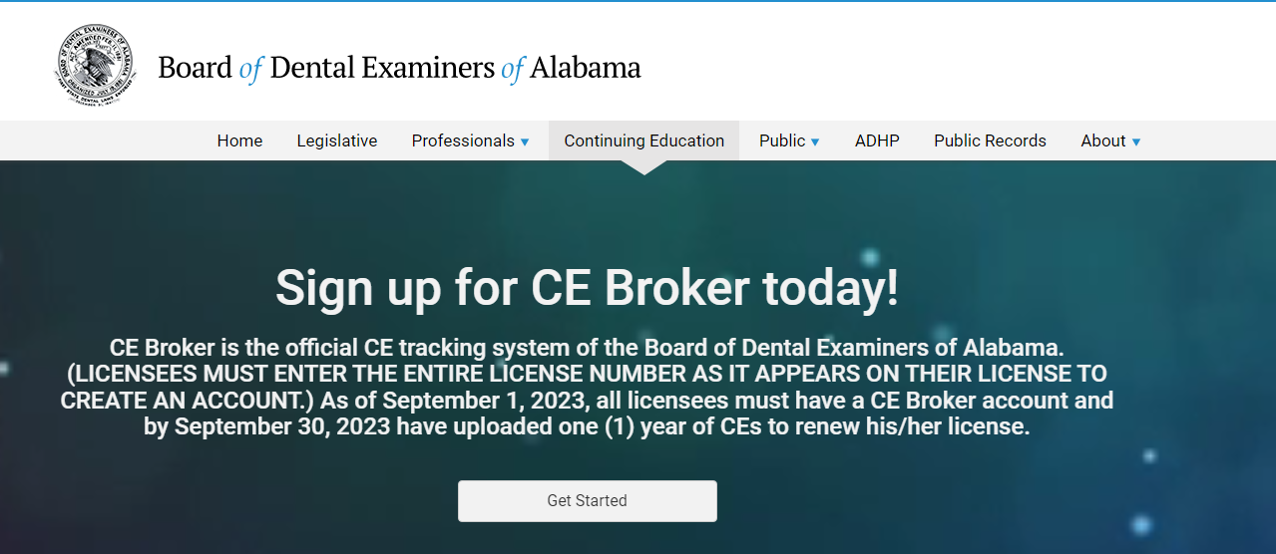
Continuing Education
CE Broker information for contact and uploading Continuing education
Video Training for CE Broker
Continuing Education Summary of Requirements for Dentists and Hygienists
CE Broker Step-by-Step Manual

Slide 11
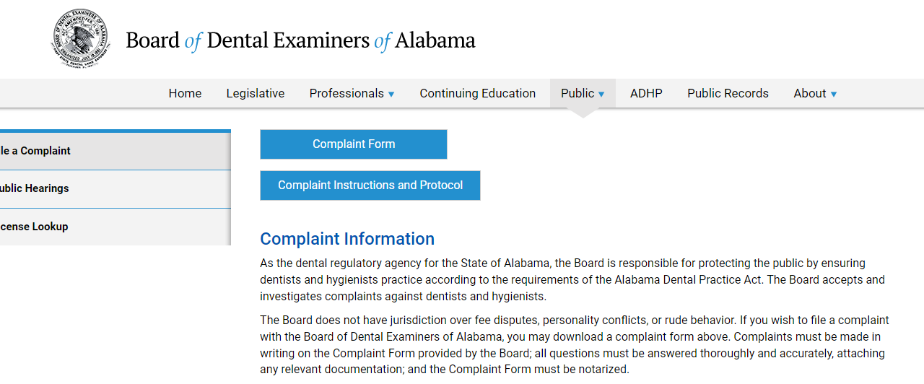
Public/File a Complaint
Complaint information – The Board of Dental Examiners is a Complaint Driven Board
Complaint Form
Complaint Instructions and Protocol

Slide 12
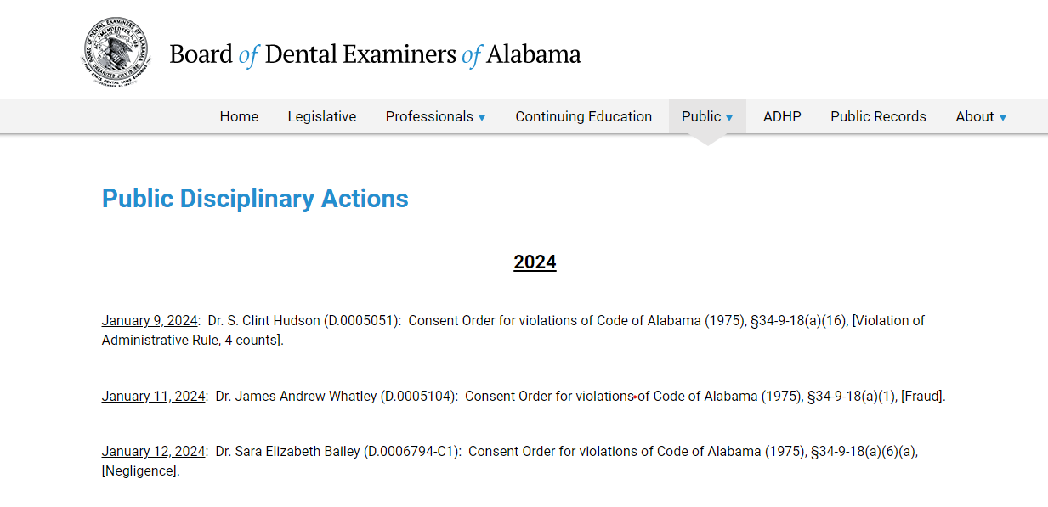
Public/Public Disciplinary Actions
Lists Public Disciplinary Actions against Dentists or Hygienists since February 2023

Slide 13
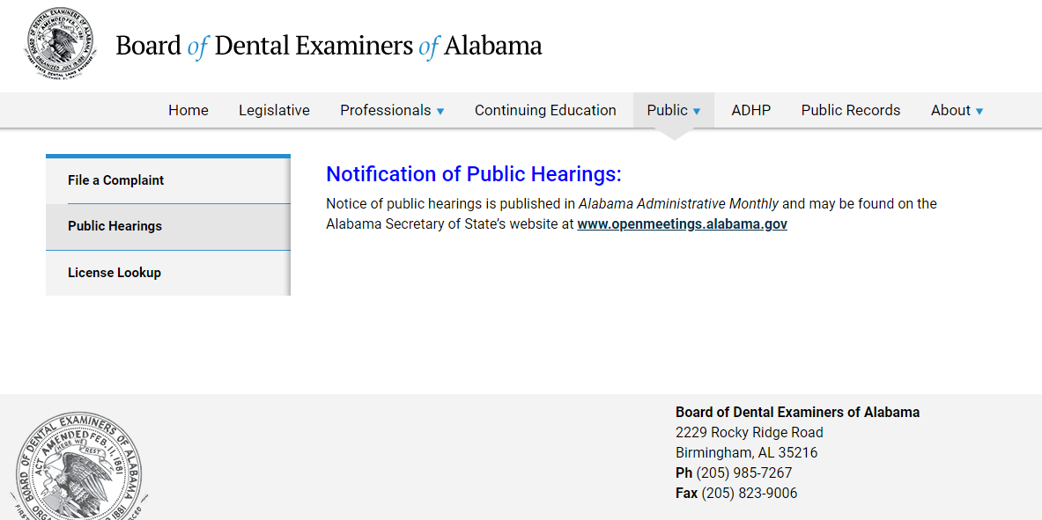
Public/Notification of Public Hearings
Information regarding any public hearings and where to find the notification

Slide 14
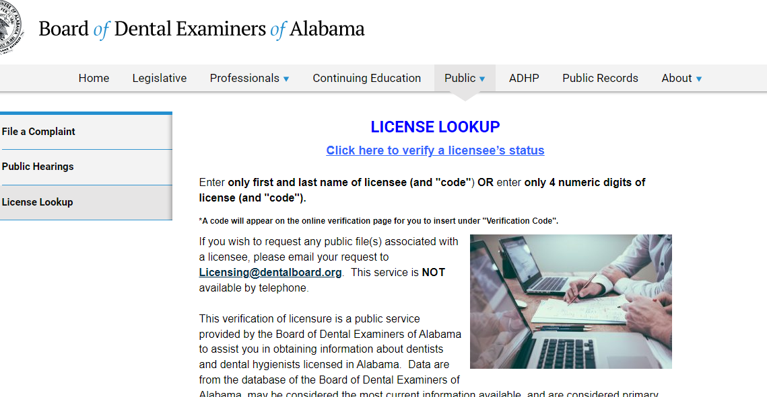
Public/License Lookup
Any member of the public (including insurance carriers) can lookup a licensee for status and public disciplinary actions.

Slide 15
Public/Education Resources
Education resources for the public regarding Opioid or Tobacco

Slide 16
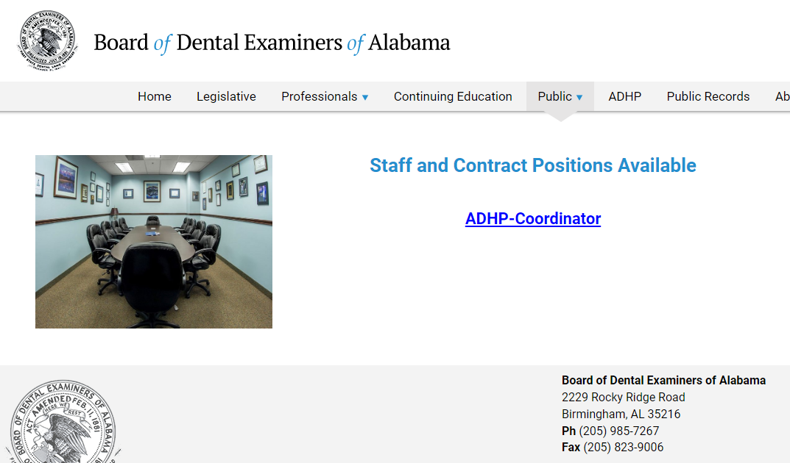
Public/Employment Opportunities
Public notice of an opening for staff or contract positions at the Board of Dental Examiners of Alabama

Slide 17
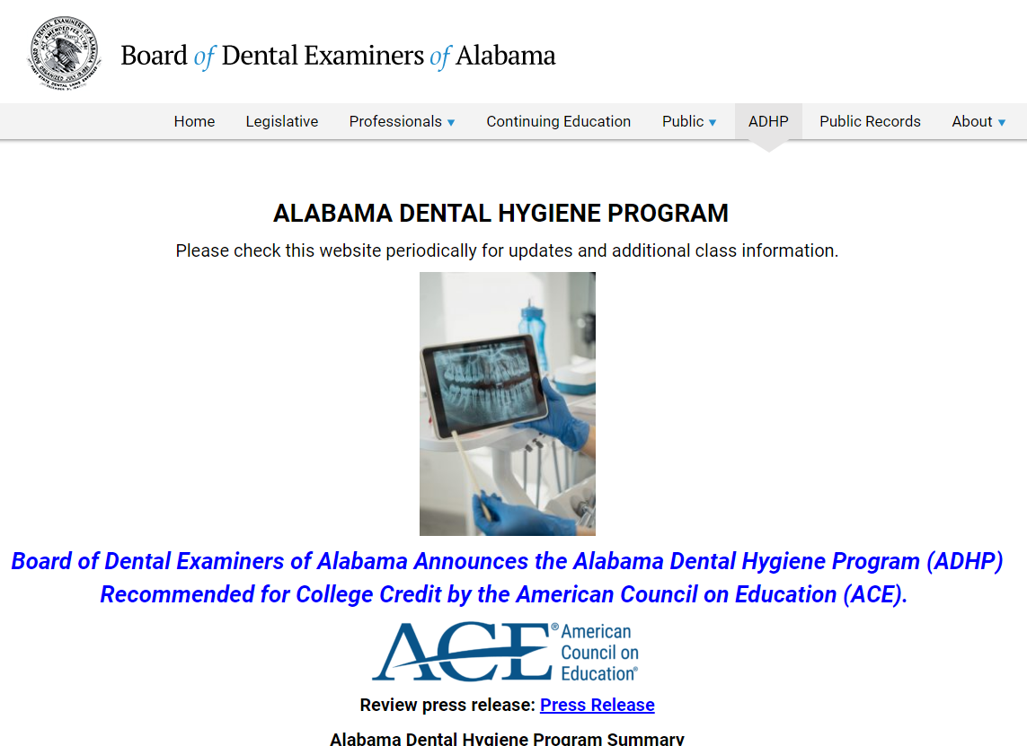
ADHP
Alabama Dental Hygiene Program
10 month program for dental assistants aspiring to become dental hygienists
Certificate program
Awarded 17 semester credit hours of post secondary credits by the American Council on Education

Slide 18
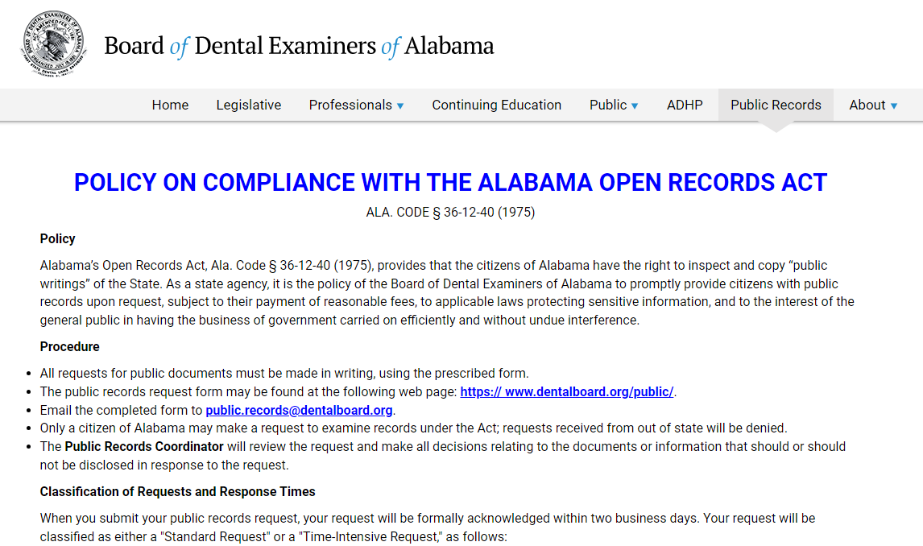
Public Records
Posted is our policy on compliance with Governor Ivey’s Alabama Open Records Act.

Slide 19
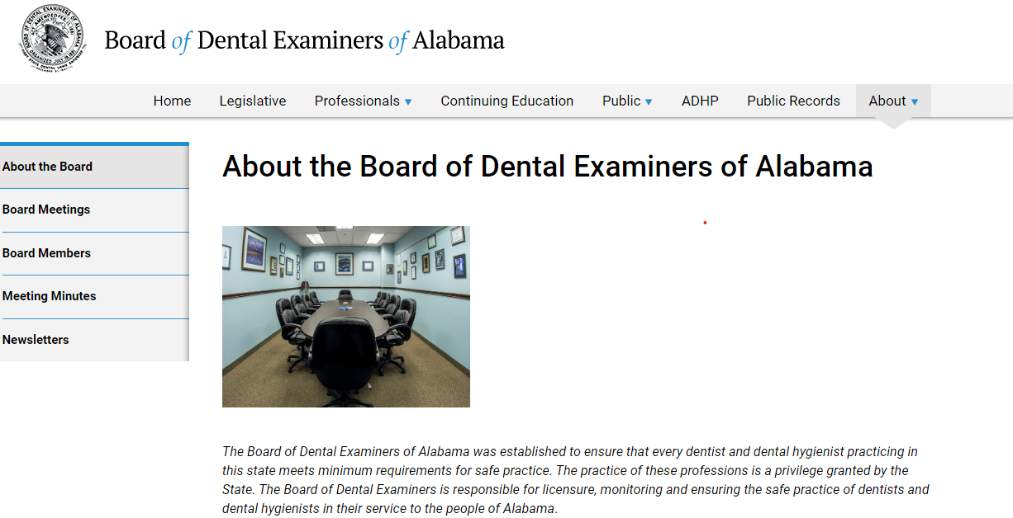
About
Historical information about the Board
Current Board members, terms, and pictures
Board meeting schedules
Meeting minutes from every Board meeting
Newsletters from the Board members
Board staff contacts, email addresses, and pictures

